Slide 1


DSC 530 Final Project
“Is The King of Basketball A Giant?”
By : Osmond Oke

Slide 2
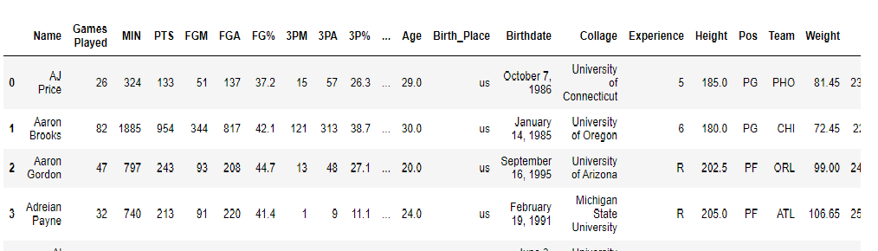
Is The King Of Basketball A Giant?
The purpose of this Exploratory Data Analysis experiment is to compare the statistics of NBA players in the 2017 season, in order to determine if the “best player” is ideally the tallest player. To do this, I obtained a Dataset of the 2017 Season, with the following variables:

Slide 3
List of Variables
Age- Age of NBA players
Games Played – Number of games played by each player
MIN – Number of minutes played by player
PTS – Number of points scored by player
Pt/min – Variable created by dividing the number of points by minutes played
Height – Heights of Basketball players
Weight – Weights of basketball players

Slide 4
Histogram of Variables
Here we have different histogram plots of our variables:

Slide 5
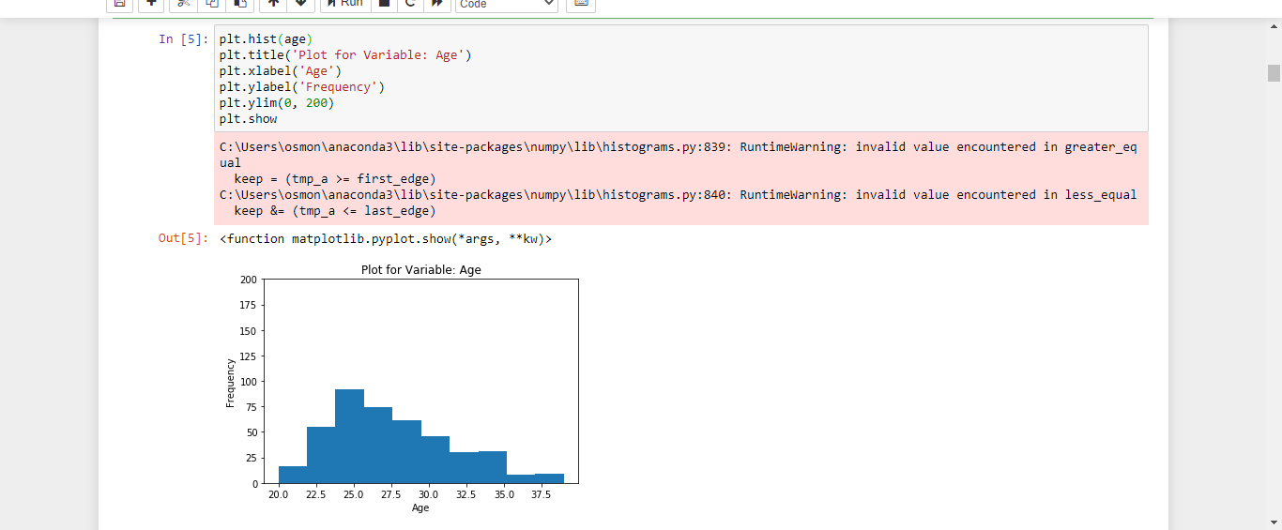
Age

Slide 6
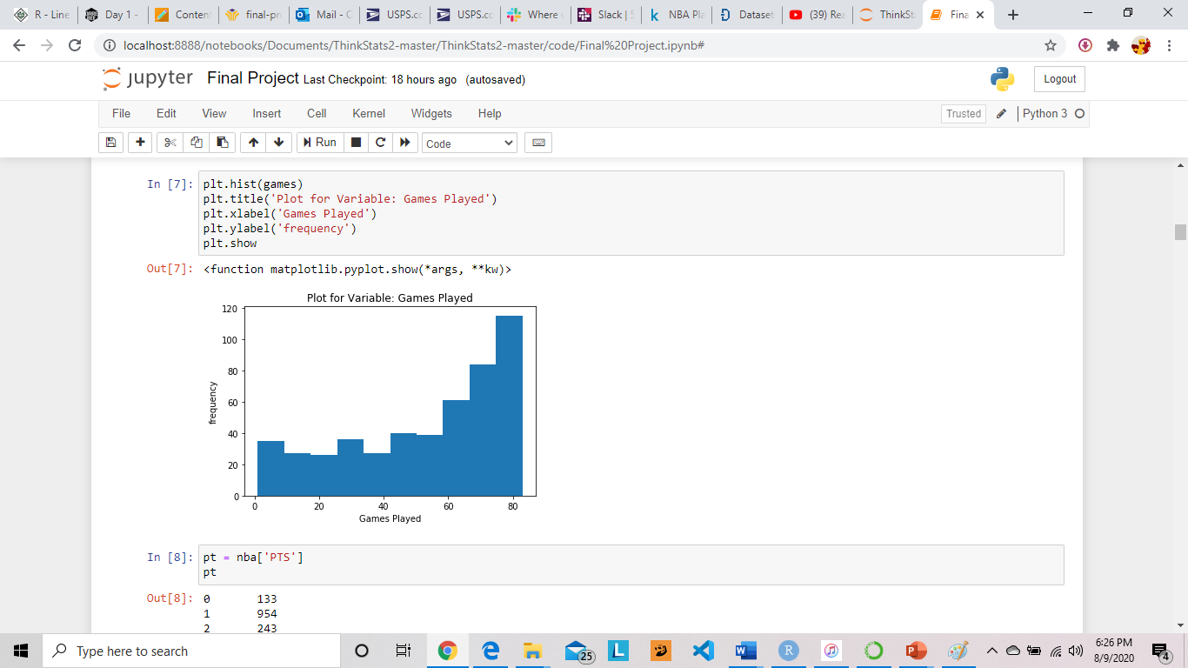
Games Played

Slide 7
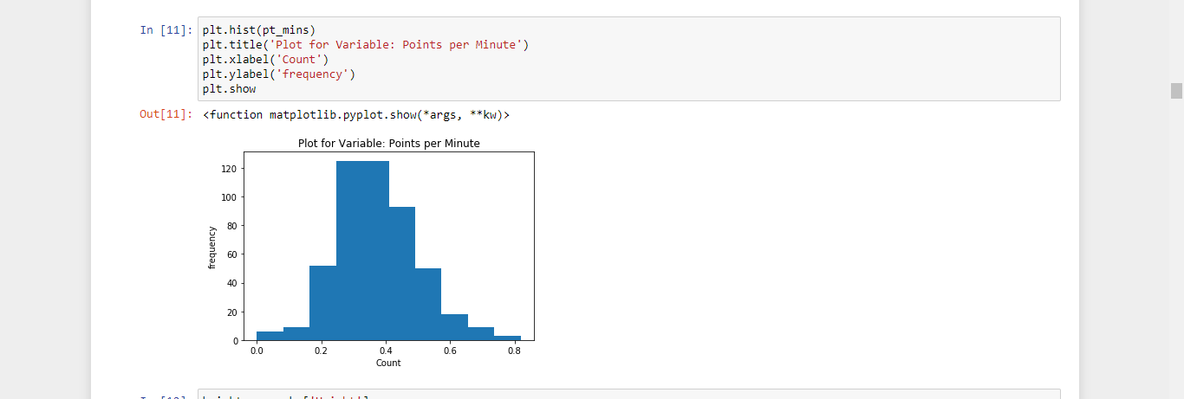
Pt/Min

Slide 8
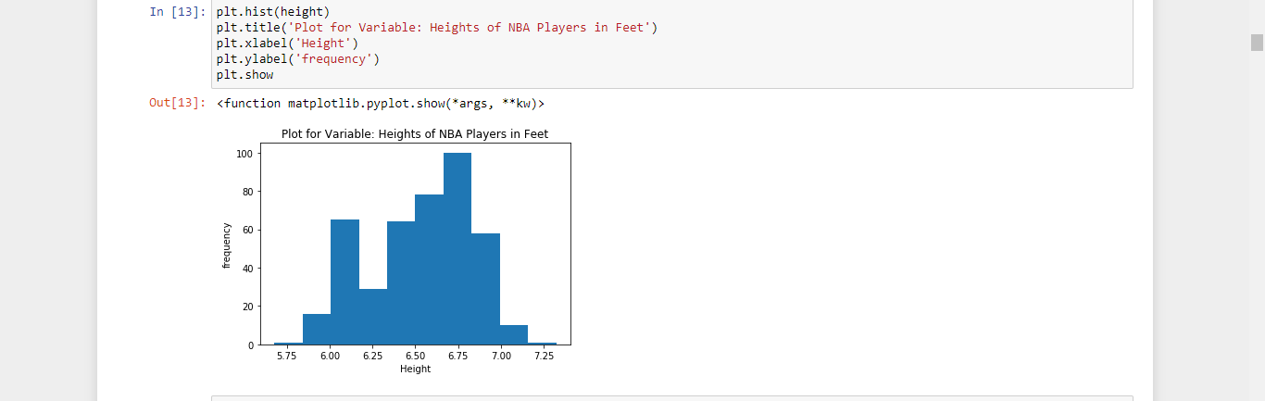
Height

Slide 9
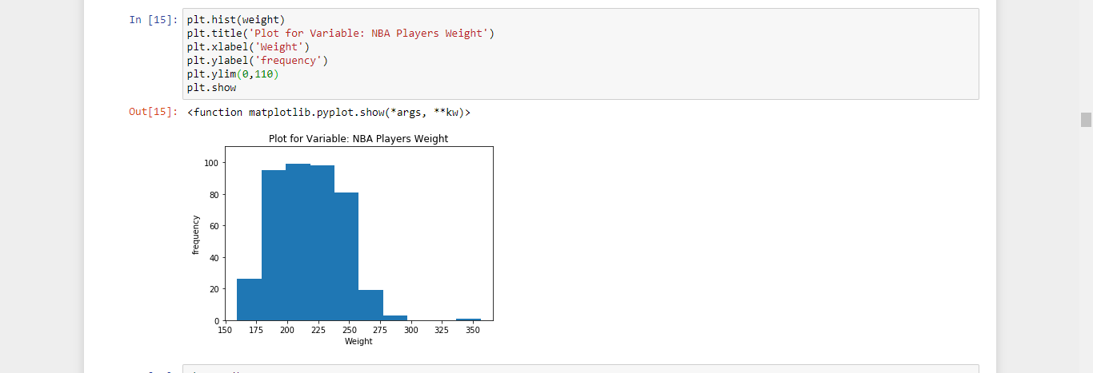
Weight

Slide 10
Descriptive Statistics
Here We look at the Descriptive Statistics of the variables:

Slide 11
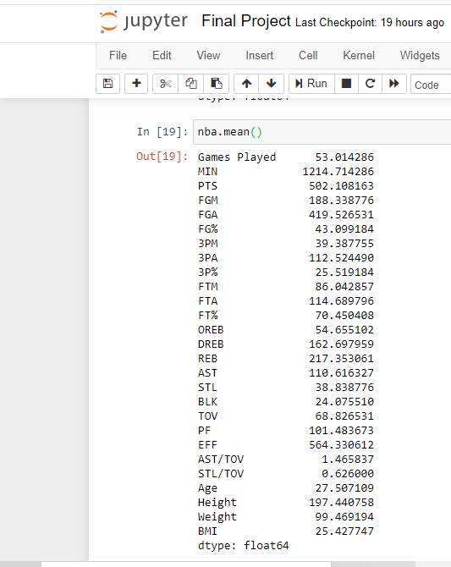
Mean

Slide 12
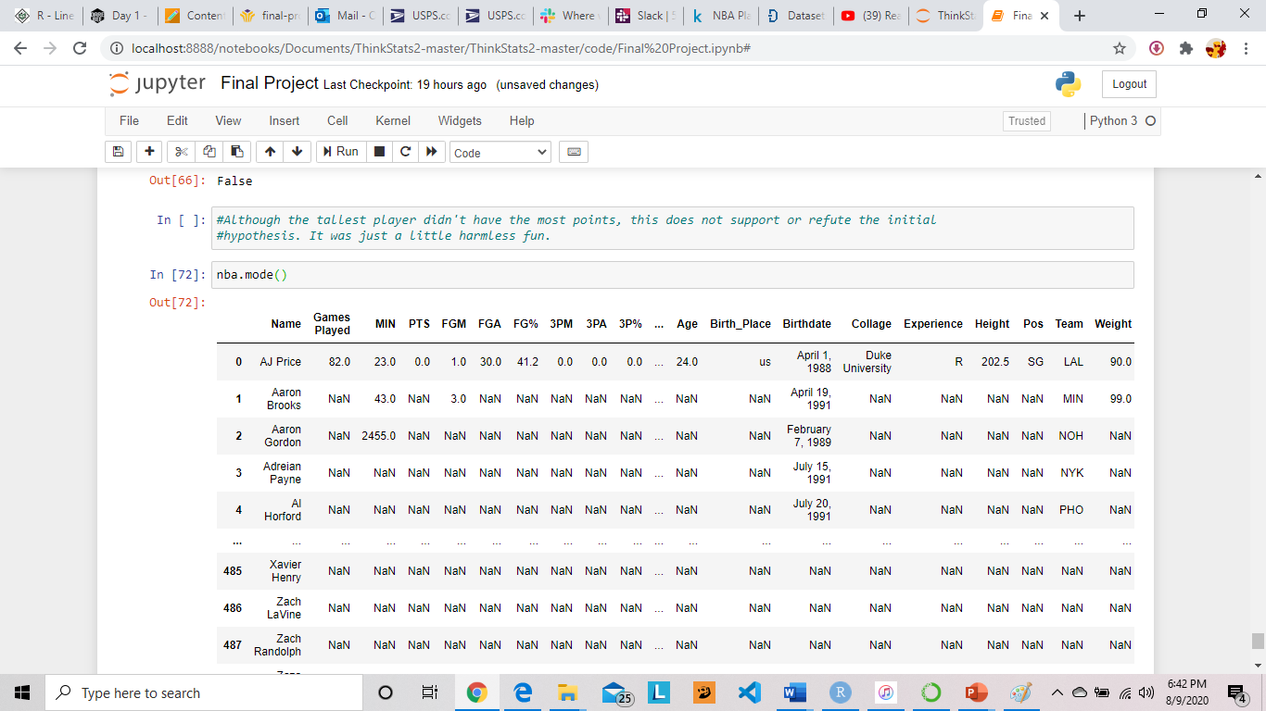
Mode

Slide 13
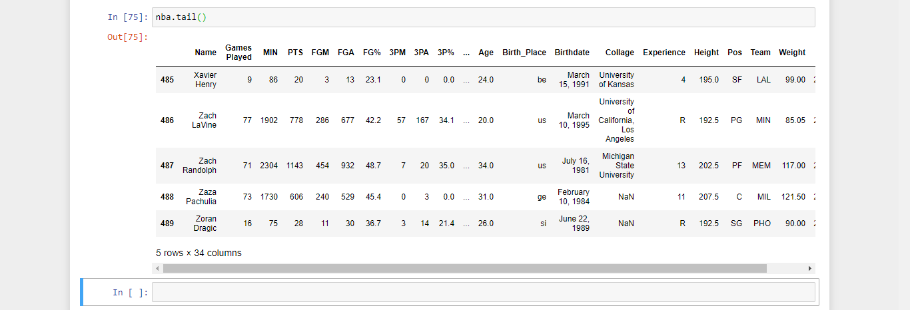
Tails

Slide 14
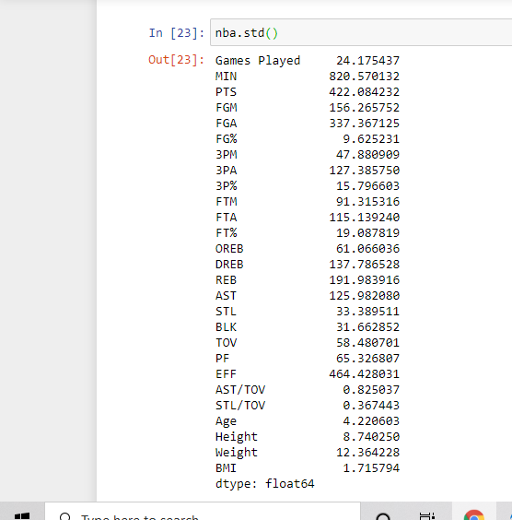
Standard Deviation

Slide 15

Variance

Slide 16
PMF
The Probability Mass Function is a function that gives the probability that a discrete random variable is exactly equal to some value. Sometimes it is also known as the discrete density function. Below, The PMF from the EDA can be seen.

Slide 17
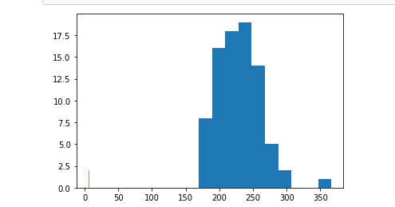
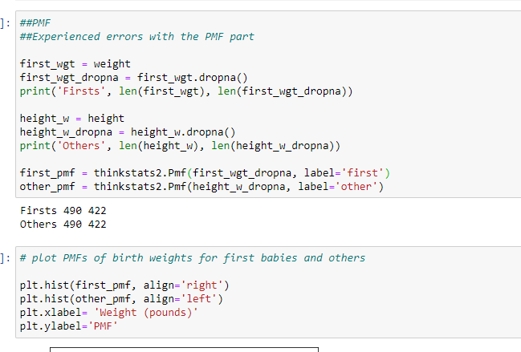
PMF

Slide 18
CDF
The cumulative distribution function of a real-valued random variable, or just distribution function of, evaluated at, is the probability that will take a value less than or equal to.

Slide 19
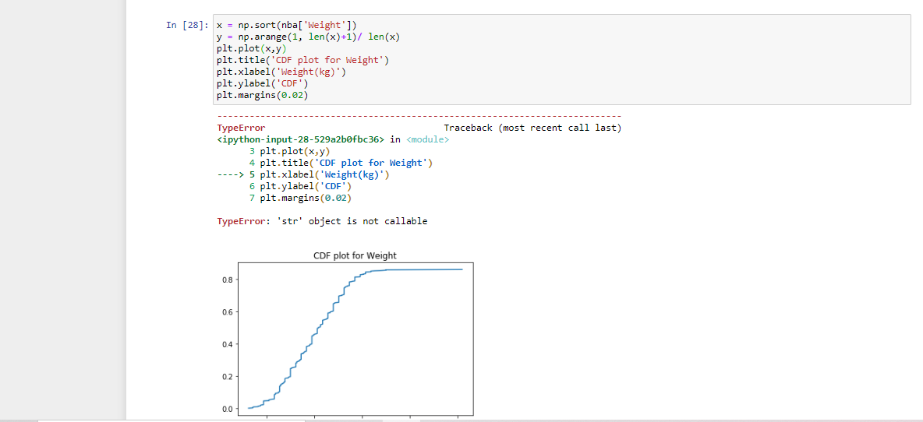
CDF

Slide 20
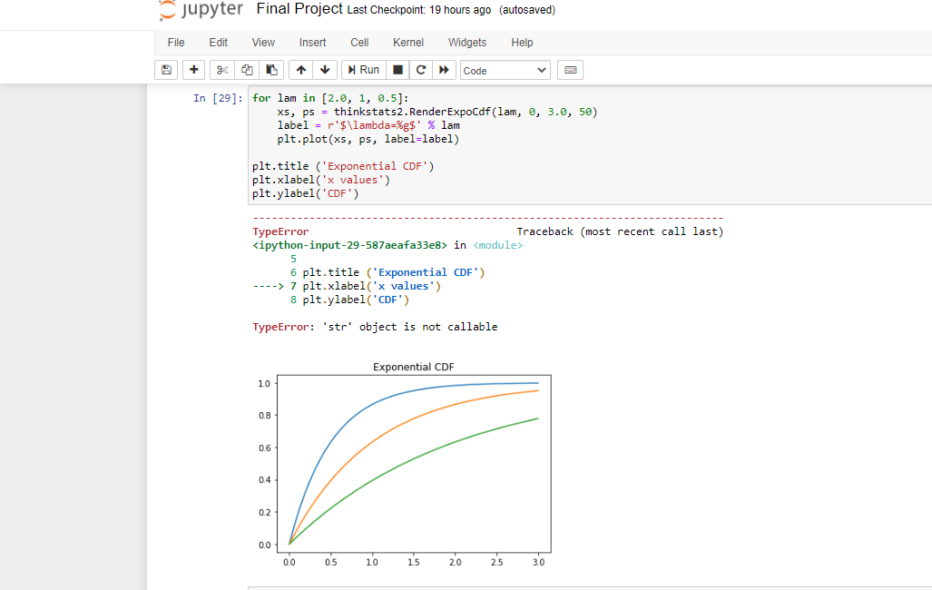
Exponential CDF

Slide 21
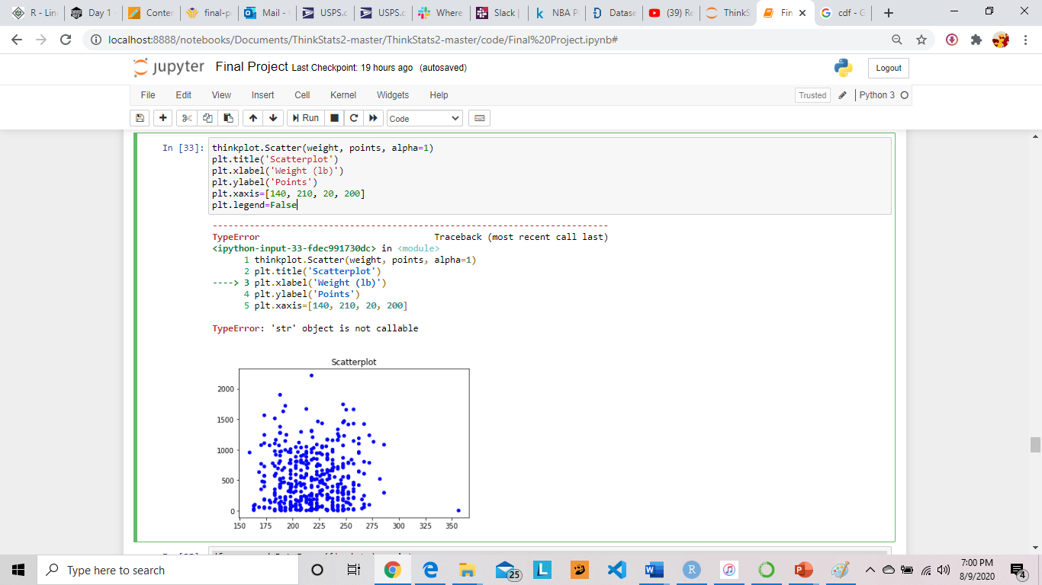
Scatter Plots to Compare Variables
Plot for Weight of players vs points scored

Slide 22
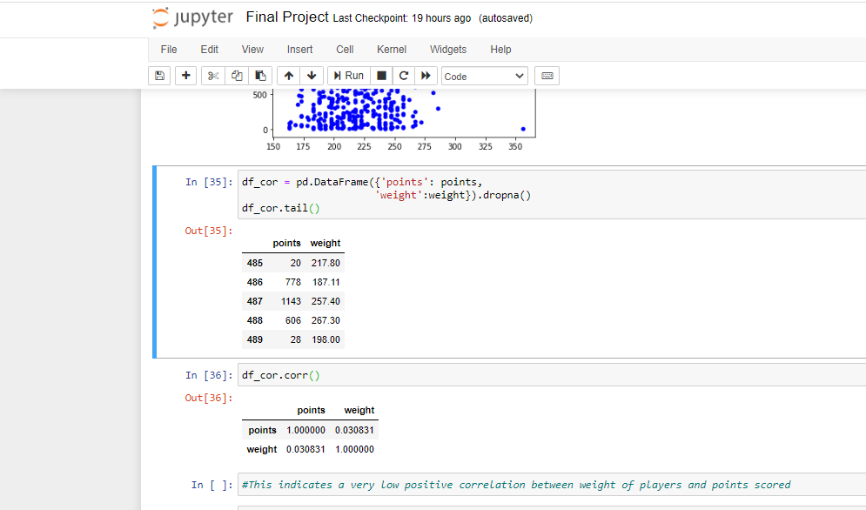
Correlation Test for Plot

Slide 23
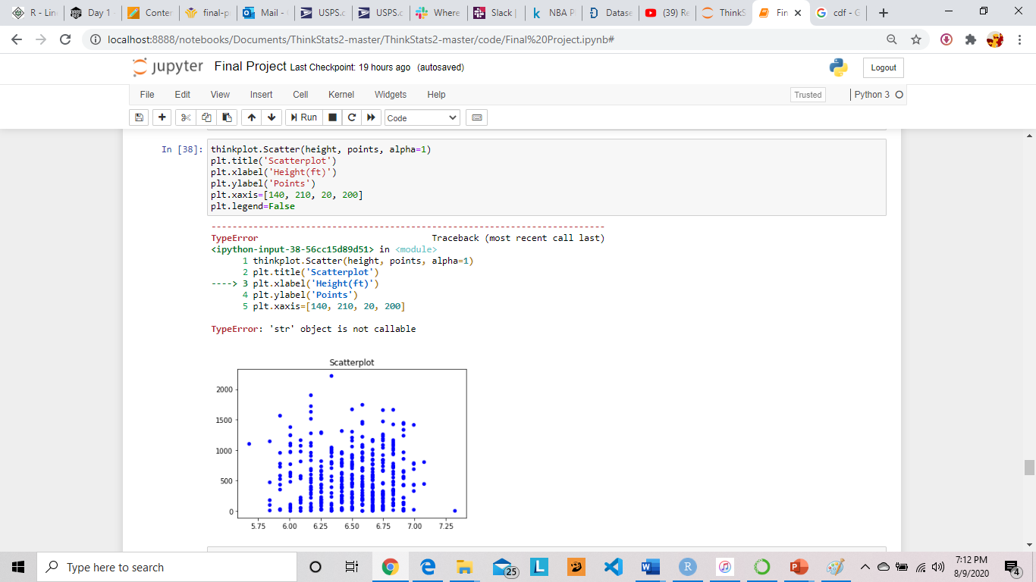
Scatterplot for Players’ Height vs Points Scored

Slide 24
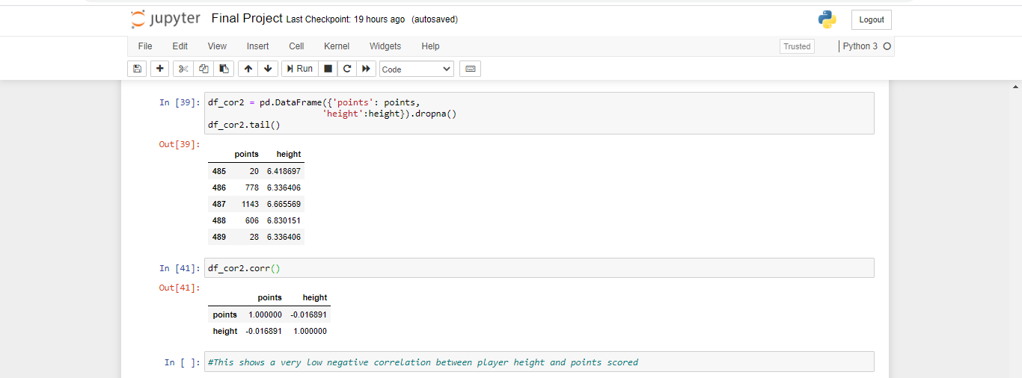
Correlation Test for Plot

Slide 25
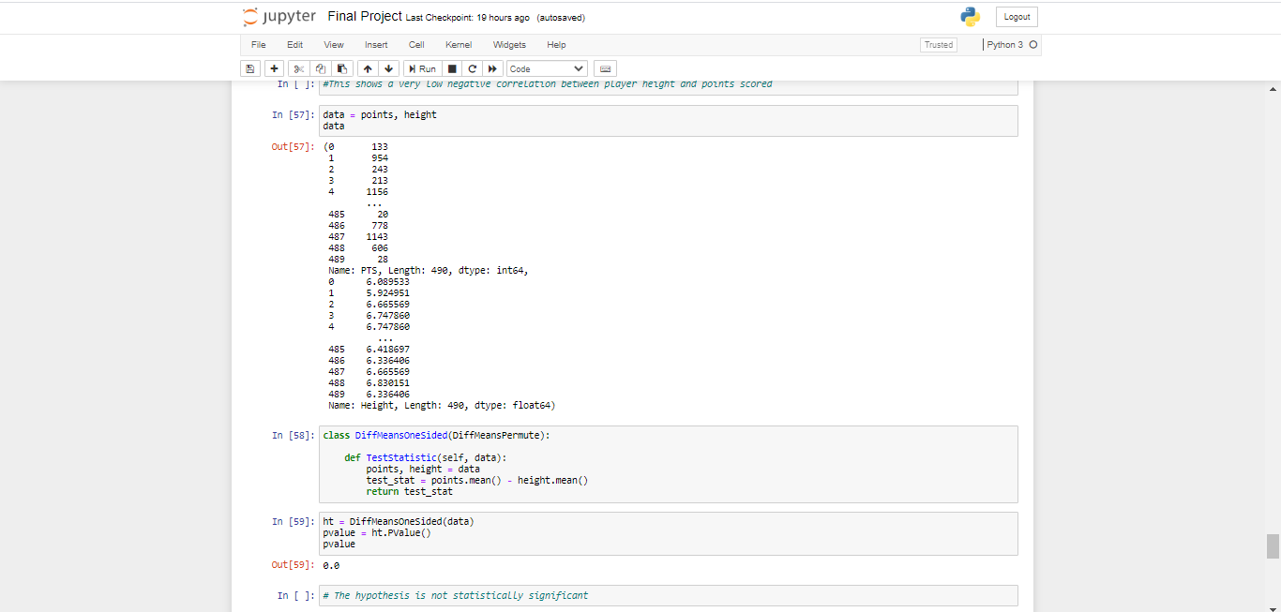
Testing the Hypothesis

Slide 26
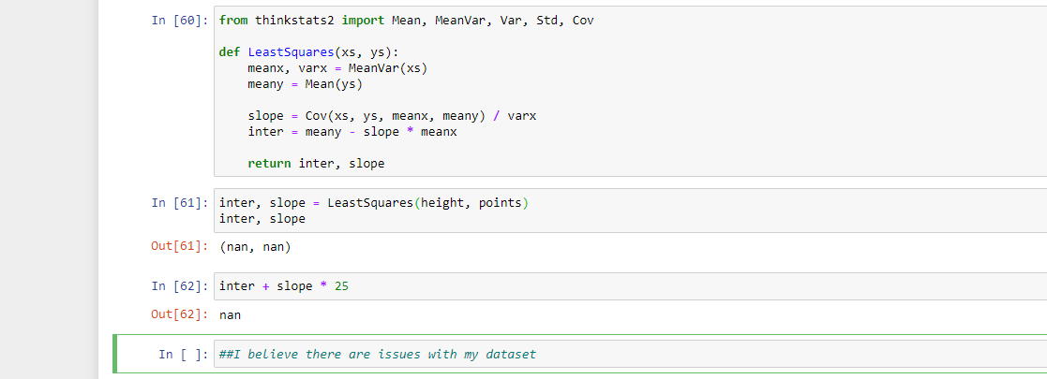
Regression Analysis
I experienced trouble with this part. I believe the problem had more to do with my dataset than calculations, but it was still a combination of both.

Slide 27
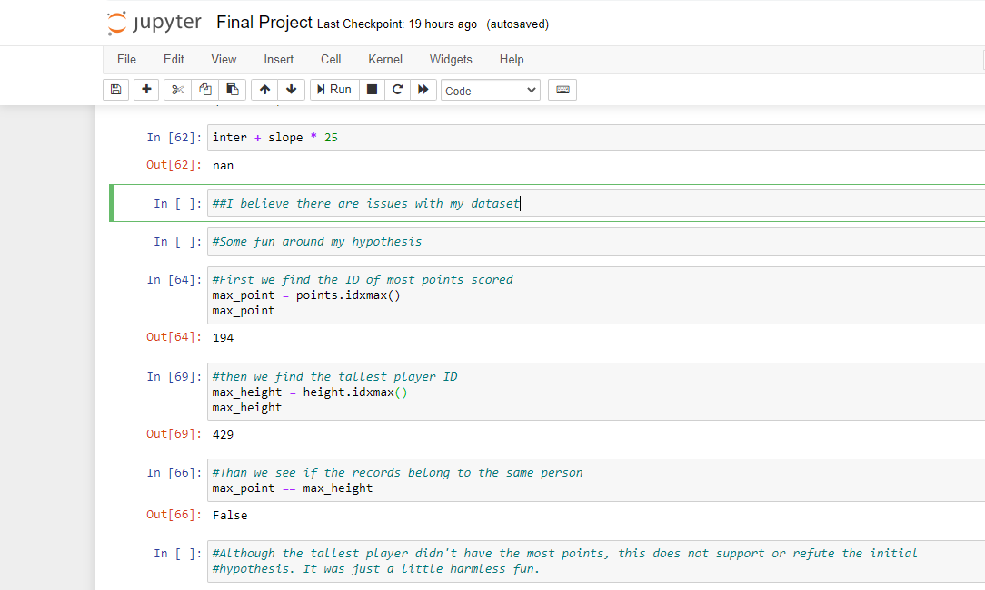
Just For Fun

Slide 28
Notable Findings
I Found that my Hypothesis was statistically insignificant.
I also found out that the tallest player is not necessarily the “best” basketball player.

Slide 29
Comments
In the future, I would recommend finding a better dataset for smoother calculations, and also a more thought through hypothesis, in order to uphold a level of statistical significance.

Slide 30
THANK YOU!!

